Slide 1
PRICE OPTIMIZATION OF PRODUCTS
SUBMITTED TO :-MR. SHUBHAM VERMA
SUBMITTED By :-Rahul Nyati

Slide 2
INTRODUCTION
Pricing a product is a crucial aspect in any business. Alot of thought process is out into it. There are different strategies to price different kinds of products. There are products whose sales are quite sensitive to their prices and as such a small change in their price can lead to noticeable change in their sales. While there are products whose sales are not much affected by their price - these tend to be either luxury items or necessities (like certain medicines).

Slide 3
What is price of a product ?
Pricing is the process whereby a business sets the price at which it will sell its products and services, and may be part of the business's marketing plan. In setting prices, the business will take into account the price at which it could acquire the goods, the manufacturing cost, the marketplace, competition, market condition, brand, and quality of product.

Slide 4
How the price affects the sales?
Assuming your costs remain the same, lowering prices to increase sales also lowers the profit margin you make on each unit that you sell. ... Sometimes, raising the price of your product or service will lead to higher profit margins but will lower your sales volumes.

Slide 5
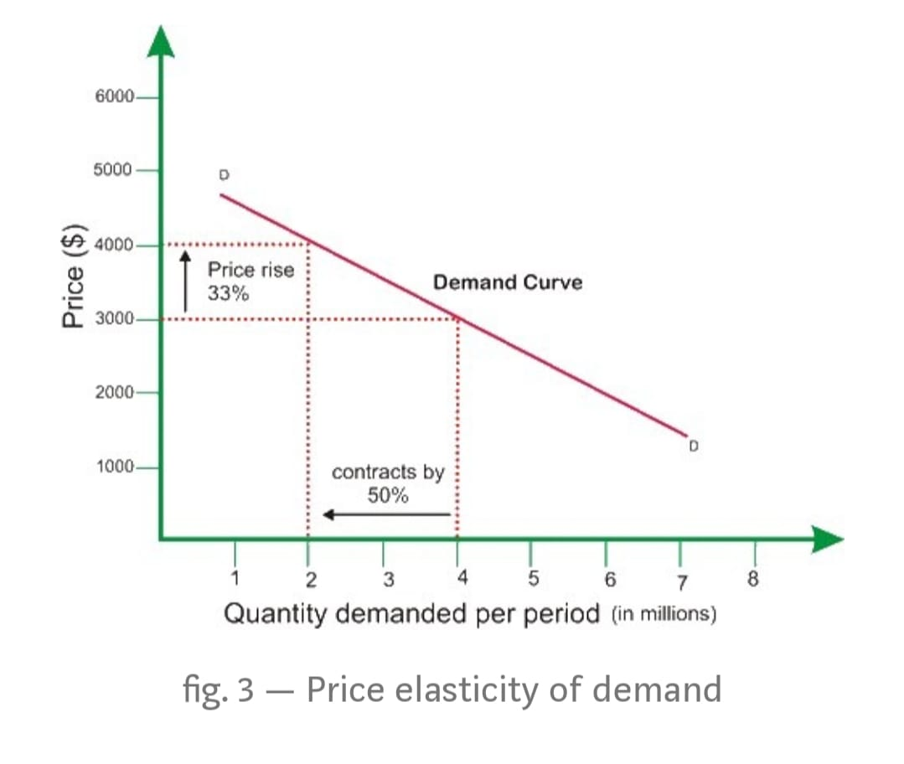
How the price affects the sales?

Slide 6
It’s clear from the Above previous picture that if the price is set at $3.000, the products sold are 4 millions.But if instead the price is increased to $4.000, the products sold are only 2 millions.

Slide 7
Before optimize the price of product FIRST Define perfect audience
Opportunistic
Premium Market
Price
High Price
High Price
Low Quality
High Quality
Chinese Good Market
Value For Money
Low Price
Low Price
Low Quality
Good Quality
Quality

Slide 8
Working flow of project:-
I Divide my project into 12 Tasks
TASK 1:-Study about the PRICE OPTIMIZATION
TASK 2:-Data Collection
TASK 3:-Data Pre-processing
TASK 4:-EDA(Exploratory Data Analysis)
TASK 5:-Combining the datasets
TASK 6:-Uncovering Facets of Data With help of visualization

Slide 9
TASK 7:-Calculating the Price elasticity of any one product using function .
TASK 8:-Then Calculate the price elasticity of other product using function calling.
TASK 9:-Create model using OLS and apply on all products.
TASK 10:-Finding the optimal price for maximum profit.
TASK 11:-Profit Maximization for all products .
TASK 12:-Conclusion.

Slide 10
TASK 1:-Study about the PRICE OPTIMIZATION
Price optimization is the use of mathematical analysis by a company to determine how customers will respond to different prices for its products and services through different channels.It is also used to determine the prices that the company determines will best meet its objectives such as maximizing operating profit. The data used in price optimization can include survey data, operating costs, inventories, and historic prices & sales. Price optimization practice has been implemented in industries including retail, banking, airlines, casinos, hotels, car rental, cruise lines and insurance industries.

Slide 11
TASK 1:-Study about the PRICE OPTIMIZATION cont……
Mathematically speaking, the price elasticity of demand is defined to be the percentage change in quantity demanded, q,divided by the percentage change in price, p. The formula for the price elasticity (ǫ) is:
𝑒=%Δ𝑄/%Δ𝑃

Slide 12
TASK 2:-Data Collection
we collected the data from below link in my case the data contains 3 CSV Files which contains Transaction Data,product selling data ,and Transaction Details Data
Data Set Link :-

Slide 13
TASK 3:-Data Pre-processing
We divide the Data pre-processing in to different segements like
1. Loading the dataset
2.Dealing with missing data
3.Classifying the dependent and Independent Variables
4.Dealing with categorical data
5.Splitting the dataset into training and testing sets
6.Scaling the features

Slide 14
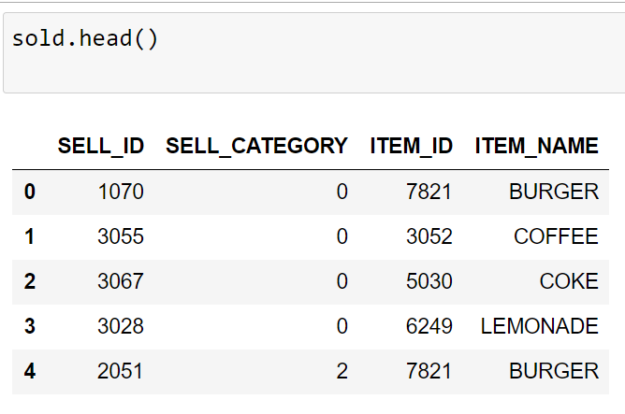
1. Loading the dataset
sold = pd.read_csv('sell.csv')
trans = pd.read_csv('transaction.csv')
dinfo = pd.read_csv('info.csv')

Slide 15
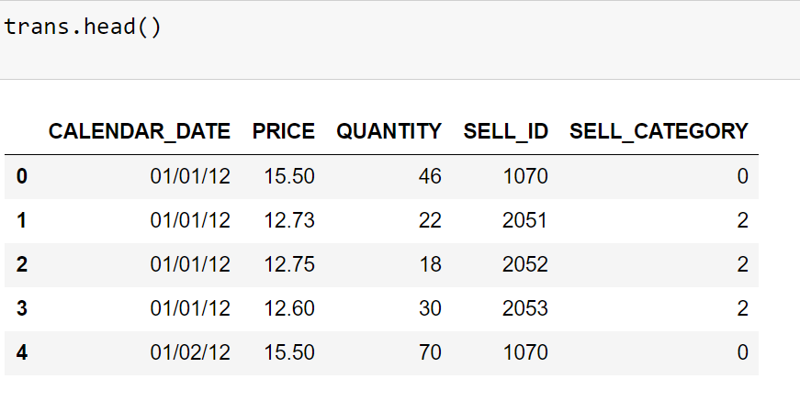
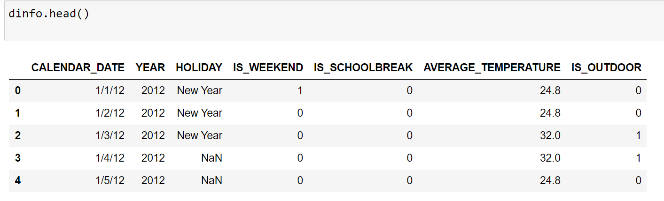

Slide 16
2.Dealing with missing data
We have already noticed the missing fields in the data denoted by “NAN”. Machine learning models cannot accommodate missing fields in the data they are provided with.So the missing fields must be filled with values that will not affect the variance of the data or make it more noisy.
Now, we check the missing values in our data sets in python and if any missing values found then filled with appropriate value instead of ‘NAN’

Slide 17
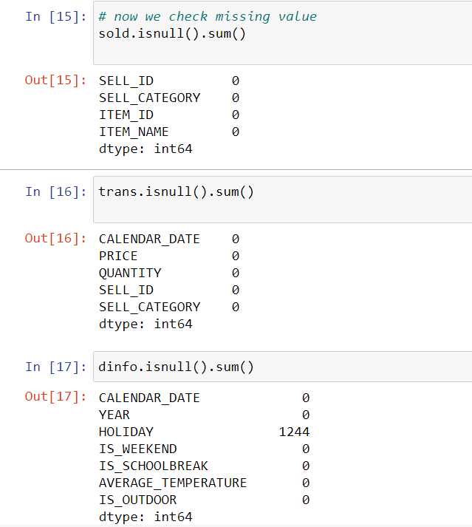

Slide 18
How to deal with missing values
In Our case the missing values found in dinfo data and in dinfo data set the missing values are in ‘Holiday’ column.
Now filled the missing values.
dinfo['HOLIDAY'] =dinfo['HOLIDAY'].fillna("No Holiday")
we filled the missing value by ‘No Holiday’ because our data in nominal

Slide 19
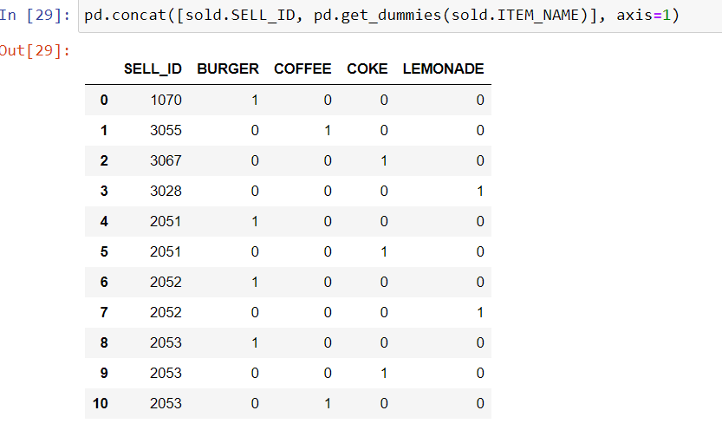
3.Classifying the dependent and Independent Variables
In our case the quantity is the independent variable and price is the dependent variable
4.Dealing with categorical data
In our case the dependent and independent variable both are numerical so we no need to deal with and categorical data but we required when we combine the data.

Slide 20
5.Splitting the dataset into training and testing sets
All machine learning models require us to provide a training set for the machine so that the model can train from that data to understand the relations between features and can predict for new observations.When we are provided a single huge dataset with too much of observations ,it is a good idea to split the dataset into to two, a training_set and a test_set, so that we can test our model after its been trained with the training_set.
Scikit-learn comes with a method called train_test_split to help us with this task.
from sklearn.model_selection import train_test_split X_train, X_test, Y_train, Y_test = train_test_split(X, Y, test_size = 0.3, random_state = 0)
test_size: the desired size of the test_set. 0.3 denotes 30%.
random_state: This is used to preserve the uniqueness. The split will happen uniquely for a random_state.
Note:-But In Our Case No Need to split the data in to Training and testing sets

Slide 21
6.Scaling the features
Since machine learning models rely on numbers to solve relations it is important to have similarly scaled data in a dataset. Scaling ensures that all data in a dataset falls in the same range.Unscaled data can cause inaccurate or false predictions.Some machine learning algorithms can handle feature scaling on its own and doesn’t require it explicitly.
The StandardScaler class from the scikit-learn library can help us scale the dataset.
from sklearn.preprocessing import StandardScaler sc_X = StandardScaler() X_train = sc_X.fit_transform(X_train) X_test = sc_X.transform(X_test)
sc_y = StandardScaler() Y_train = Y_train.reshape((len(Y_train), 1)) Y_train = sc_y.fit_transform(Y_train) Y_train = Y_train.ravel()
Note:-In Our case No need to scale the data because the data is fallen in range that’s why we don’t need

Slide 22
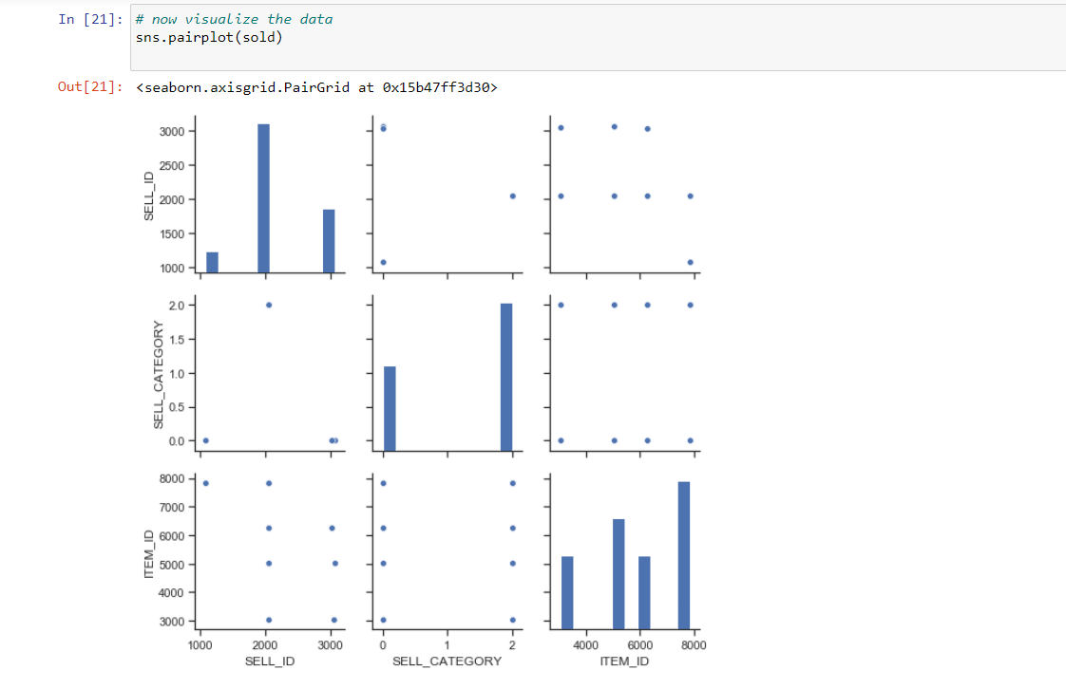
TASK 4:-EDA(Exploratory Data Analysis)

Slide 23
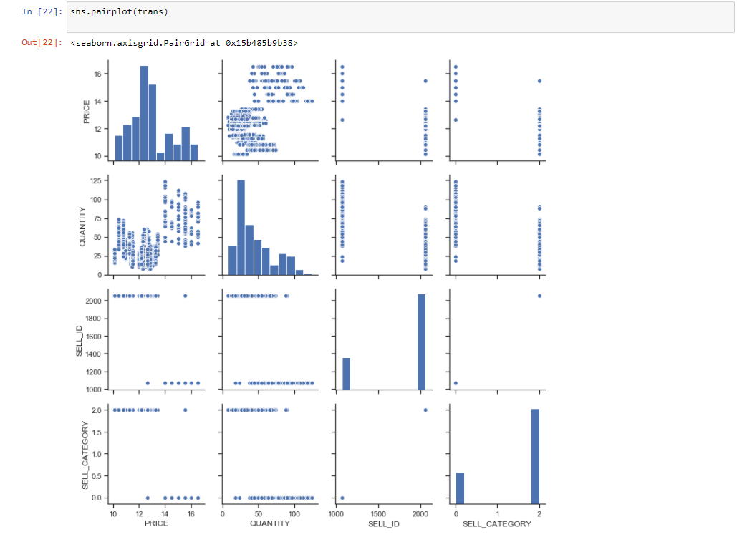

Slide 24
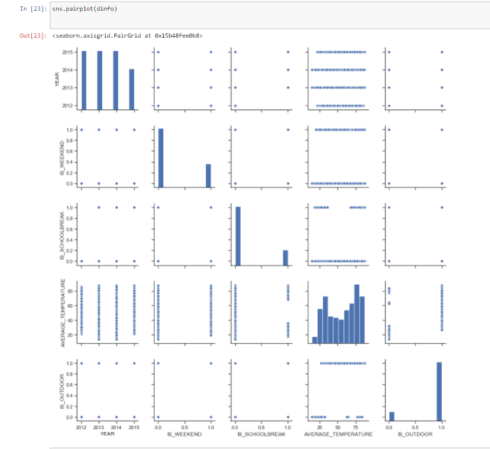

Slide 25
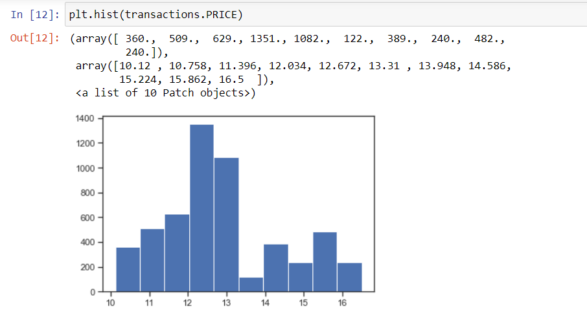
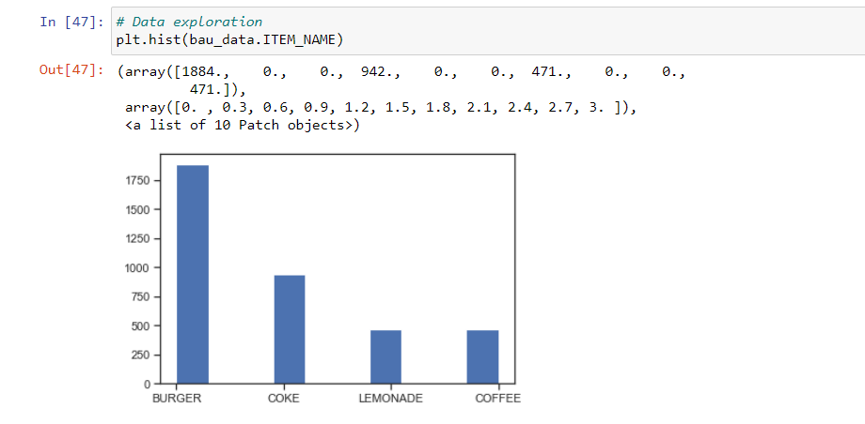

Slide 26
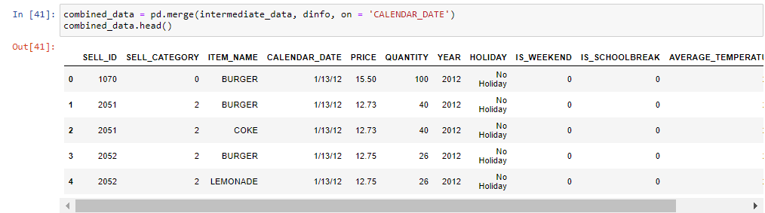
TASK 5:-Combining the datasets

Slide 27
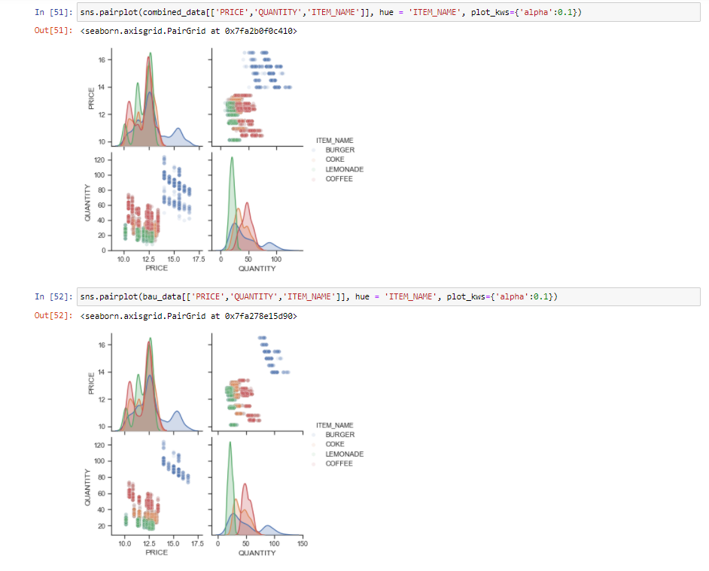
TASK 6:-Uncovering Facets of Data With help of visualization

Slide 28
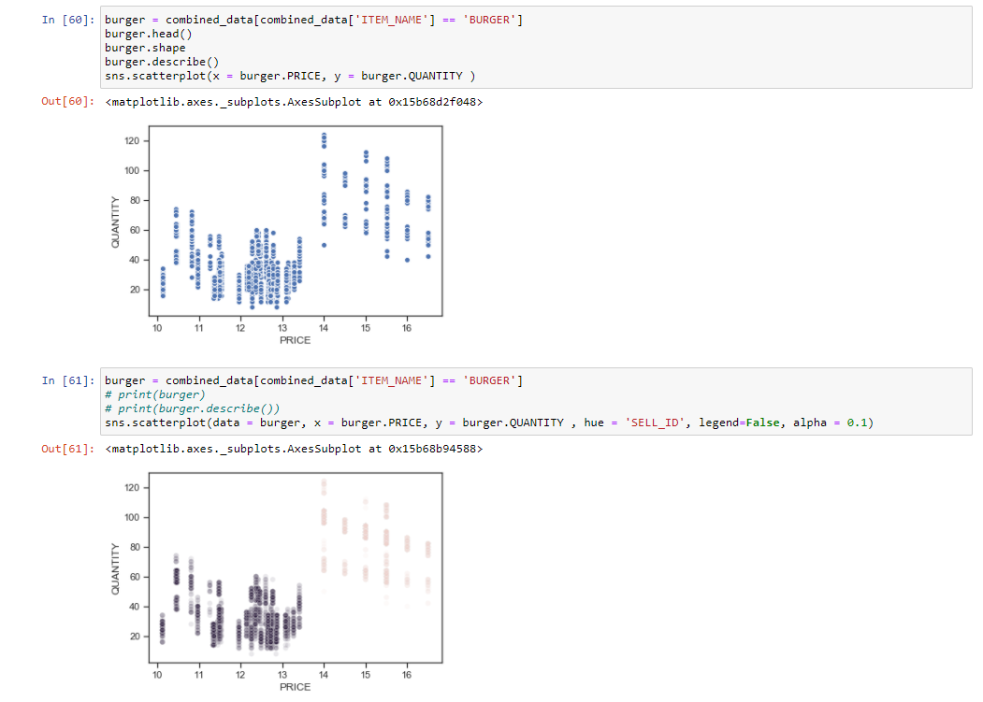

Slide 29
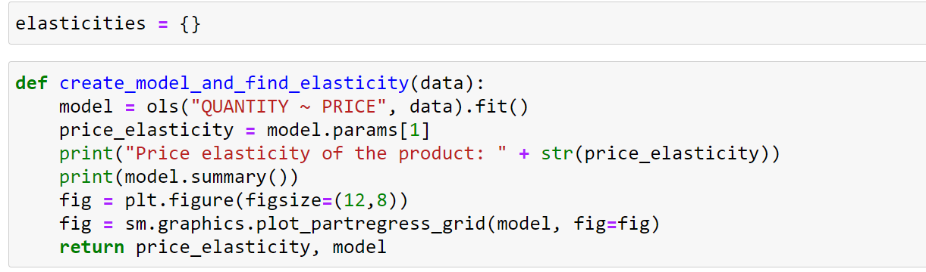
TASK 7:-Calculating the Price elasticity of any one product using function .

Slide 30
TASK 8:-Then Calculate the price elasticity of other product using function calling.
1)burger1070_data = bau2_data[(bau2_data['ITEM_NAME'] == "BURGER") & (bau2_data['SELL_ID'] == 1070)]
elasticities['burger_1070'], model_burger_1070 = create_model_and_find_elasticity(burger1070_data)
2) burger2051_data = bau2_data[(bau2_data['ITEM_NAME'] == "BURGER") & (bau2_data['SELL_ID'] == 2051)]
elasticities['burger_2051'], model_burger_2051 = create_model_and_find_elasticity(burger2051_data)
3)burger2053_data = bau2_data[(bau2_data['ITEM_NAME'] == "BURGER") & (bau2_data['SELL_ID'] == 2053)]
elasticities['burger_2053'], model_burger_2053 = create_model_and_find_elasticity(burger2053_data)
4) 1)burger2052_data = bau2_data[(bau2_data['ITEM_NAME'] == "BURGER") & (bau2_data['SELL_ID'] == 2052)]
elasticities['burger_2052'], model_burger_2052 = create_model_and_find_elasticity(burger2052_data)
)

Slide 31
5) coke_data_2053 = bau2_data[(bau2_data['ITEM_NAME'] == "COKE") & (bau2_data['SELL_ID'] == 2053)]
elasticities['coke_2053'], model_coke_2053 = create_model_and_find_elasticity(coke_data_2053)
6) coke_data_2051 = bau2_data[(bau2_data['ITEM_NAME'] == "COKE") & (bau2_data['SELL_ID'] == 2051)]
elasticities['coke_2051'], model_coke_2051 = create_model_and_find_elasticity(coke_data_2051
7) lemonade_data_2052 = bau2_data[(bau2_data['ITEM_NAME'] == "LEMONADE") & (bau2_data['SELL_ID'] == 2052)]
elasticities['lemonade_2052'], model_lemonade_2052 = create_model_and_find_elasticity(lemonade_data_2052)
8) coffee_data_2053 = bau2_data[(bau2_data['ITEM_NAME'] == "COFFEE") & (bau2_data['SELL_ID'] == 2053)]
elasticities['coffee_2053'], model_coffee_2053 = create_model_and_find_elasticity(coffee_data_2053)

Slide 32
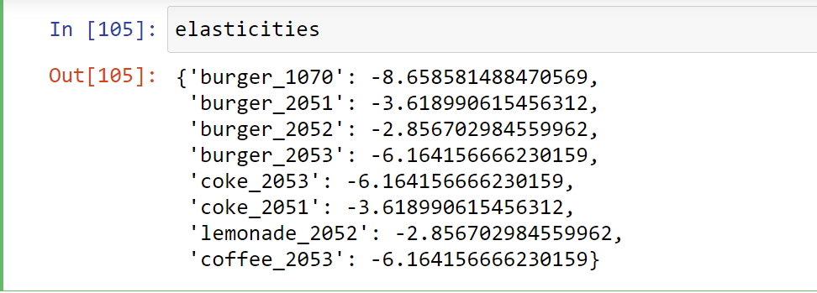

Slide 33
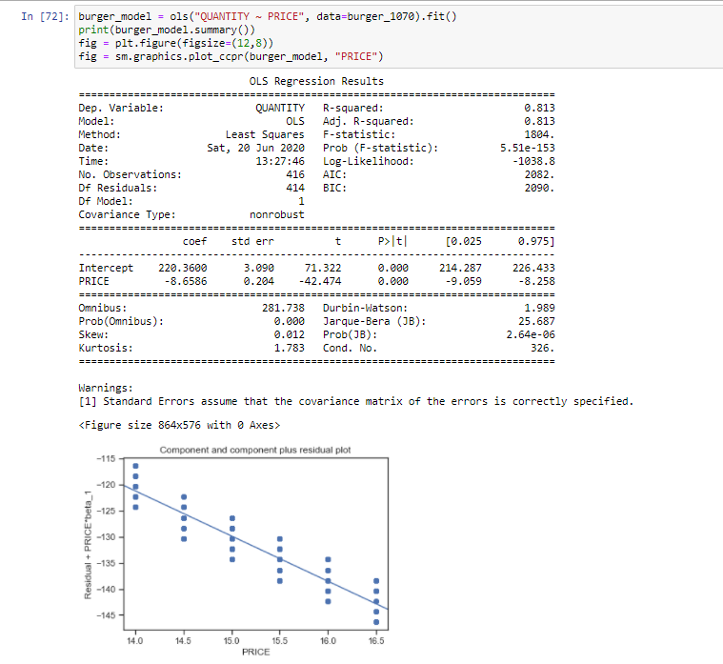
TASK 9:-Create model using OLS and apply on all products.

Slide 34
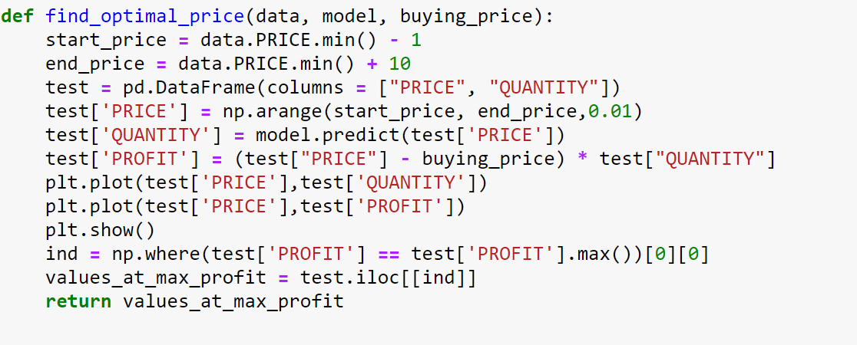
TASK 10:-Finding the optimal price for maximum profit.

Slide 35
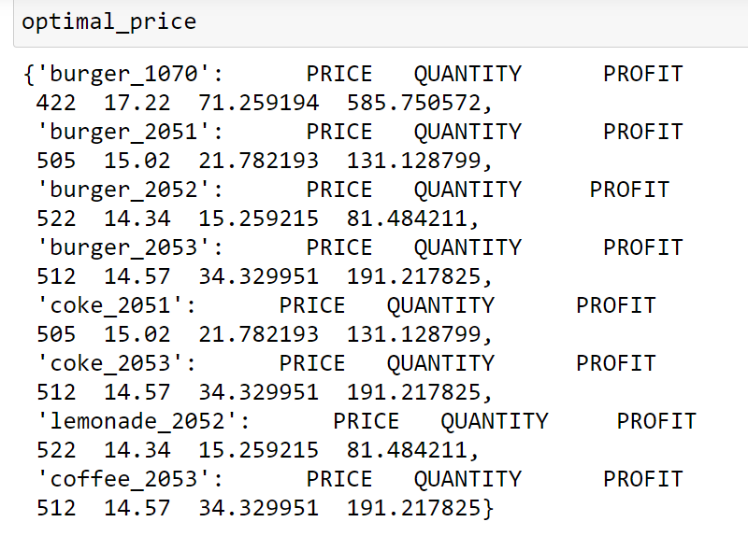
TASK 11:-Profit Maximization for all products .

Slide 36
TASK 12:-Conclusion.
This is the price the cafe should set on it's item to earn maximum profit based on it's previous sales data. It is important to note that this is on a normal day. On 'other' days such as a holiday, or an event taking place have a different impact on customer buying behaviours and pattern. Usually an increase in consumption is seen on such days. These must be treated separately. Similarly, it is important to remove any external effects other than price that will affect the purchase behaviours of customers including the datapoints when the item was on discount.
Once, the new prices are put up, it is important to continuously monitor the sales and profit. If this method of pricing is a part of a rpoduct, a dashboard can be created for the purpose of monitoring these items and calculating the lift in the profit.

Slide 37
Scope:-
BASICALLY MY PROJECT GIVES ANSWERS TO SUCH QUESTIONS LIKE:-
“If I lower the price of a product, how much more will sell?”
“If I raise the price of one product, how will that affect sales of the other products?”
“If the market price of a product goes down, how much will that affect the amount that firms will be willing to supply to the market?”

Slide 38
THANKS

